Slide 1

Intro to Network Security
WAN to LAN

Slide 2
Topics (a few)
(De)perimeterisation
BGP Attacks
Distributed Denial of Service
Malware Analysis (and Incentives)
Insider Risk
Intrusion Detection and Mitigation
Firewalls, Firewalls, Firewalls (and other filtering)
ROC Curve
Detection Systems
Benford’s Law
Honeypots
Cryptography (HTTPS)
XSS
Tools

Slide 3
Definition of Network Security
Security Engineering which focuses on
integrating threat hunting
firewalls and other filters
intrusion detection
network logging
supporting services

Slide 4
Intro
Network Security is a big topic
We are going to focus on WAN to CAN, Enterprise, or LAN
The Internet is a Wide Area Network (the biggest)
Our network is usually an Enterprise or Campus Area Network
Or a Local Area Network (depends on size)
Why is it impossible to ignore the internet today?

Slide 5
Why web-based first?
How many items at your home are connected to the internet?
The internet has become a fact of business and life so we cannot ignore it when it comes to security.

Slide 6
There is a non-internet connected system
A Standalone computer is not connected to any network
Sometimes called a blackbox
Used to test items & ensure safety of certain things
We will focus on virtual cause cheaper
Blackbox to check Codeblocks
Setup an IoT Device (raspberry) and downloaded installer
Installed and watched
It wasn’t bad (leaky but not bad)
Virtual Network to check Codeblocks
Installed a VM and disconnected from internal network
It was its own LAN (connected to nothing)

Slide 7
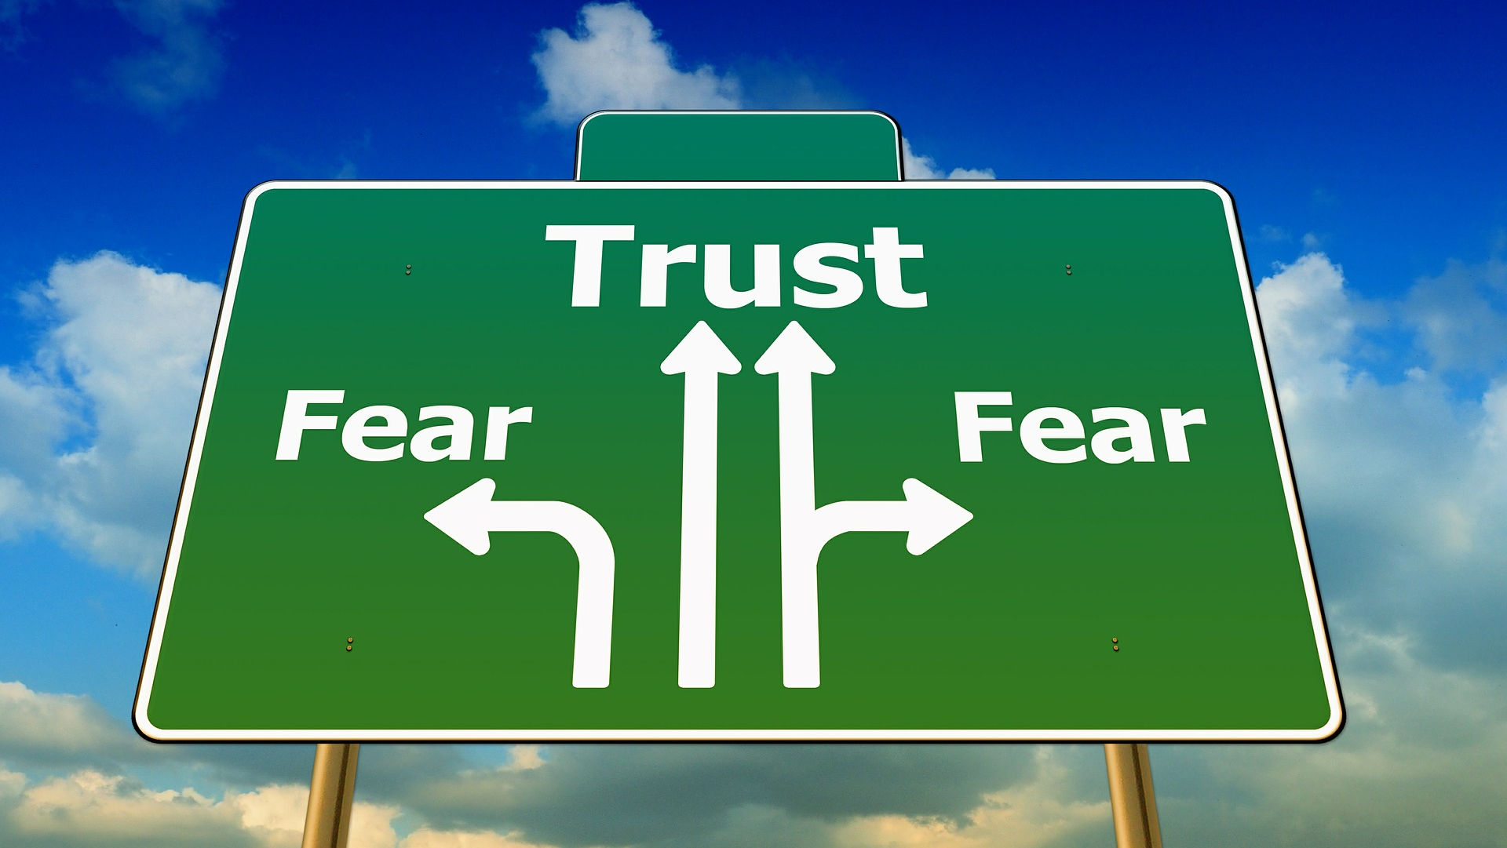
Let’s look at internal vs. external & how this effects:
See the board
This Photo by Unknown Author is licensed under CC BY-SA

Slide 8
Perimeterization
A conceptual internal network vs. the outside (internet)
Single point of entry for untrusted devices
A filter (firewall) between External and Internal
Other layers of security should also exist
Idea is to localize and isolate your internal network to limit potential for attacks
Internal network consists of Trusted devices
Old School: “Trust but verify”
What issues do we see here?

Slide 9
Issues
Internal threats are not accounted for and always potential emergencies
This includes malicious internal actors
BYOD’s having malware from usage at home and then being attached to network
Phishing email was received at home and attachment with Trojan is downloaded
Jumping the Firewall is possible (usb, social engineering, physical security failures, etc.)
Remote Work just doesn’t fit the model
If Firewall is breached or jumped:
Internal trust ensures breach will be substantial
None to Few barriers between attackers and more internal systems
Old protocols and lack of updates on firewall?

Slide 10
De-Perimeterization (Google BeyondCorp)
Moves trust from Edge of “internal” network to a verification of each device and connection
“Never Trust, Always Verify”
Zero-Trust Security
No to little firewalls (in network itself)
Configure each device to tight Access Security Controls
Authenticate (all the verification systems)
Authorize (all the authorization techniques)
Layered Defense on each device (attack vectors and counter measures)
Idea is localization is impossible so ensure every entry into system is Fort Knox
What issues & benefits do we see here?

Slide 11
Benefits & Issues
Benefits
Several levels more secure than Perimeterization
BYOD’s are now handled or at least mitigated
Cannot connect without full protections
Firewall is on device itself not network (with VPN, AV, etc.)
Works with Remote Work
If breached helps limit damage (cannot jump without new verifications)
Issues
Not always possible (next)
Legacy protocol support can make this impossible to setup
Internal network cannot have protection so must use traditional (IoT & Smart, vendors, etc.)

Slide 12

Let’s look at that “curve”
Note, in real-world we use a hybrid (mix the two methods up as we have to)

Slide 13
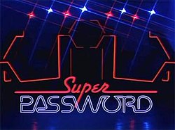
A scenario
Password Policy:
You must reset your password every 60 days
It must be 15-18 characters in length
Include at least 1: number, lowercase character, and uppercase character
Include 1 of the following (and only these) special chars: #, !, *
You cannot reuse an old (last 5) password or be within 3 chars of them
What is the problem with this?
This Photo by Unknown Author is licensed under CC BY-SA

Slide 14
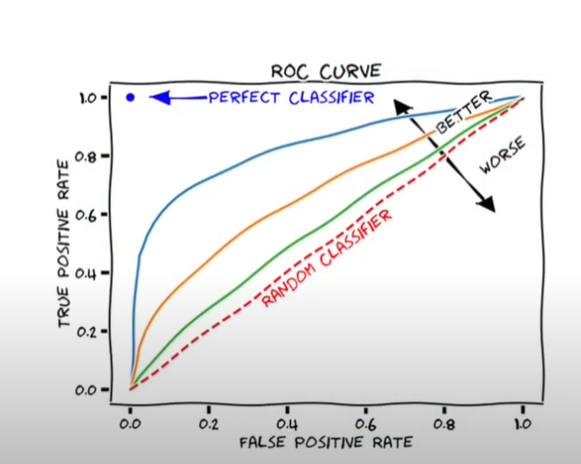
Receiver Operating Curve
Called the “ROC” Curve because it puts you between a Rock and a Hard Place
The point when the:
Expense
Usability
Performance
Understandability
Of security measures, hinders their performance

Slide 15
A good stopping point
Thursday – more network security and our red vs. blue
Moving to Malware in-depth (and their actors), internal defenses, BGP, and botnets

